Slide 1

Digital Image Processing
BCSE403L
Fall Semester 2024-25
Defect Detection in Solar Panels
Faculty Name: Dr. Geetha S.
Team Members:
Rethvik Menon C 21BCE1197
Varshini Subramanian 21BCE1015

Slide 2
Abstract
The increasing global energy consumption, driven by population growth and technological advancements, highlights the urgent need for reliable, cost-effective, and sustainable renewable energy sources. Solar energy emerges as a viable solution to address these challenges, particularly through the use of photovoltaic (PV) panels, which convert solar radiation into electricity. However, these panels are prone to various environmental defects that must be identified and addressed promptly to maintain their efficiency and durability. This study examines the types of faults in PV panels, its supervision and the benefits of identifying faults. The study utilizes solar panel images dataset. Image processing, deep learning and object detection techniques are used for defect detection. The purpose of the proposed approach is to automate the detection process.

Slide 3
Motivation
The increasing reliance on solar energy underscores the need for effective fault detection in photovoltaic (PV) systems, as faults can significantly reduce efficiency and lead to power losses.
Environmental factors such as temperature, dust, and shading contribute to the complexity of diagnosing these issues, making robust detection methods essential for maintaining system reliability.
Recent advancements in technologies like infrared thermography and machine learning offer promising solutions for timely fault identification.
Moreover, understanding the various types of defects—ranging from installation errors to environmental impacts—can enhance the longevity and performance of solar panels.
This work aims to explore and consolidate these methodologies

Slide 4
Objectives
The objective of this paper is to develop a framework for solar panel fault detection that leverages image processing, morphological analysis, deep learning, and object detection techniques.
By integrating these methodologies, the study aims to enhance the accuracy and efficiency of defect identification in photovoltaic systems.
Specifically, the research seeks to create a robust automated system capable of detecting various faults, such as dust, discoloration, and electrical malfunctions, through detailed image analysis.

Slide 5
Base Paper 1
Fault classification using deep learning based model and impact of dust accumulation on solar photovoltaic modules
Rahma Aman, M. Rizwan & Astitva Kumar (2023)
This study investigates factors affecting solar panel performance, particularly the impact of dust accumulation on power generation.
Dust reduces sunlight reaching photovoltaic (PV) modules, increases surface temperature, and can shorten panel life.
Using a Fluke TiS60 Thermal Imager, hotspots caused by dust were detected, and images were classified using transfer learning methods with SqueezeNet and AlexNet, where AlexNet achieved a higher accuracy of 99.7%.
A controlled experiment demonstrated that power loss varied with dust thickness and coverage area, with significant losses observed at higher levels of dust.
The research aims to enhance PV inspection efficiency and accuracy in hotspot identification, while suggesting future work on developing more effective detection methods and strategies to mitigate dust effects on panels.
https://www.researchgate.net/publication/370269806_Fault_classification_using_deep_learning_based_model_and_impact_of_dust_accumulation_on_solar_photovoltaic_modules

Slide 6
Base Paper 2
Automatic Faults Detection of Photovoltaic Farms: solAIr, a Deep Learning-Based System for Thermal Images
Pierdicca, R., Paolanti, M., Felicetti, A., Piccinini, F., Zingaretti, P. (2020)
The increasing importance of renewable energy, particularly photovoltaic (PV) power plants, highlights the need for efficient health monitoring methods.
The solAIr system leverages AI and deep learning for anomaly detection in PV images captured by UAVs equipped with thermal infrared sensors.
Utilizing Mask R-CNN for object detection and instance segmentation, the system was trained and evaluated on a publicly available thermal images dataset, comparing the performance of UNet, FPNet, and LinkNet based on IoU and Dice coefficients.
Results indicated strong performance, with LinkNet excelling in the Jaccard index and UNet in the Dice index.
The solAIr system enhances fault detection in large-scale PV plants, reducing inspection costs and errors, while introducing the novel application of instance segmentation in this field.
Future improvements aim to enable multi-class segmentation, integrate GIS for operational activities, and facilitate real-time inspections through on-board UAV systems.
https://www.mdpi.com/1996-1073/13/24/6496

Slide 7
Literature Survey
Title | Author | Proposed | Inference
A multi-stage model based on YOLOv3 for defect detection in PV panels based on IR and visible imaging by unmanned aerial vehicle (2022) | Antonio Di Tommaso, Alessandro Betti, Giacomo Fontanelli, Benedetto Michelozzi | Novel multi-stage model utilizing YOLOv3 and computer vision for automatic defect detection in UAV-captured aerial images of PV panels | It is a versatile model since it processes both thermographic and visible images. It also predicts hotspot severity based on temperature gradients and computes soiling coverage.
CNN-based Deep Learning Approach for Micro-crack Detection of Solar Panels (2021) | M. R. Rahman, S. Tabassum, E. Haque, M. M. Nishat, F. Faisal and E. Hossain | Pre-trained models, including VGG-16, VGG-19, Inception-v3, Inception-ResNet50-v2, ResNet50-v2, and Xception, were trained and evaluated individually and in ensemble form on Electroluminescence images of solar panels. | The ensemble method achieved top accuracies of 96.97% for monocrystalline and 97.06% for polycrystalline panels, enhancing detection accuracy and reducing reliance on single models. . The study highlights the effectiveness of transfer learning for small datasets
Intelligent monitoring of photovoltaic panels based on infrared detection (2022) | Xing Wang, Wenxian Yang, Bo Qin, Kexiang Wei, Yunyu Ma, Daibing Zhang | The U-Net neural network is used for image segmentation. Contour area, Perimeter, Aspect ratio, and Ratio of contour area to outer rectangle were proposed to characterize mask. Decision tree classifier was then used to diagnosing PV panel faults using infrared thermal images captured by drones or remote systems | U-net neural network significantly improved the processing efficiency by working with the 'mask' of true colour infrared images to reduce interference.

Slide 8
Literature Survey
Title | Author | Proposed | Inference
Spatial distribution of solar PV deployment: an application of the region-based convolutional neural network (2023) | Kim, S.Y., Ganesan, K., Soderman, C. | A computer vision model, using Faster RCNN and Machine Learning Model using satellite images. | Faster RCNN, achieved 81% mean Average Precision (mAP) for identifying solar panels and 95% for identifying roofs. Of the 16 predictive models, XGBoost performed the best, explaining approximately 70% of the variance in rooftop solar deployment.
Infrared Thermal Images of Solar PV Panels for Fault Identification Using Image Processing Technique (2022) | V. Kirubakaran, D. M. D. Preethi, U. Arunachalam, Yarrapragada K. S. S. Rao, Mansour K. Gatasheh, Nasrul Hoda, Endalkachew Mergia Anbese | The system aims to integrate renewable energy sources with advanced image processing techniques to detect faults in solar panels, utilizing MATLAB for thermal image analysis and defect identification. | The approach effectively enhances fault detection accuracy through preprocessing, morphological techniques, and the Hough transform, ensuring reliable monitoring of solar panel integrity.
Research on detection method of photovoltaic cell surface dirt based on image processing technology (2024) | Hu, X., Du, Z. & Wang, F | This study presents an image processing method to detect dust and dirt on photovoltaic panels, utilizing techniques like image enhancement, histogram equalization, and an improved A* path planning algorithm for UAV-based detection. | The approach enhances detection efficiency and accuracy, significantly reducing operational costs and improving maintenance of photovoltaic systems by automating the identification of dirt accumulation on solar panels.

Slide 9
Proposed Method
Data Collection: Gather diverse images of solar panels under various conditions, ensuring different lighting and angles.
Preprocessing: Apply noise reduction, normalization, and enhance image quality with techniques like erosion and dilation.
Feature Extraction: Extract relevant features using edge detection, texture analysis, and morphological operations to identify faults.
Model Development: Design and train a deep learning model (e.g., CNN). Try incorporating object detection algorithms
Validation and Testing: Evaluate model performance using training, validation, and test sets
Results Analysis: Analyze and report detected faults, visualizing with bounding boxes or heatmaps for clarity.

Slide 10
Dataset: Source 1
Dataset Source: https://www.kaggle.com/datasets/pythonafroz/solar-panel-images/data
The images (total of 885) were sourced from the internet, resulting in a slight imbalance in the number of images across classes
Class | Explanation | No. of images in the class
Clean | unblemished panels | 194
Bird drop | panels with bird droppings | 192
Electrical damage | panels exhibiting electrical issues | 104
Physical Damage | panels with physical impairments | 70
Snow Covered | panels covered by snow | 124
Dusty | panels affected by dust | 191

Slide 11
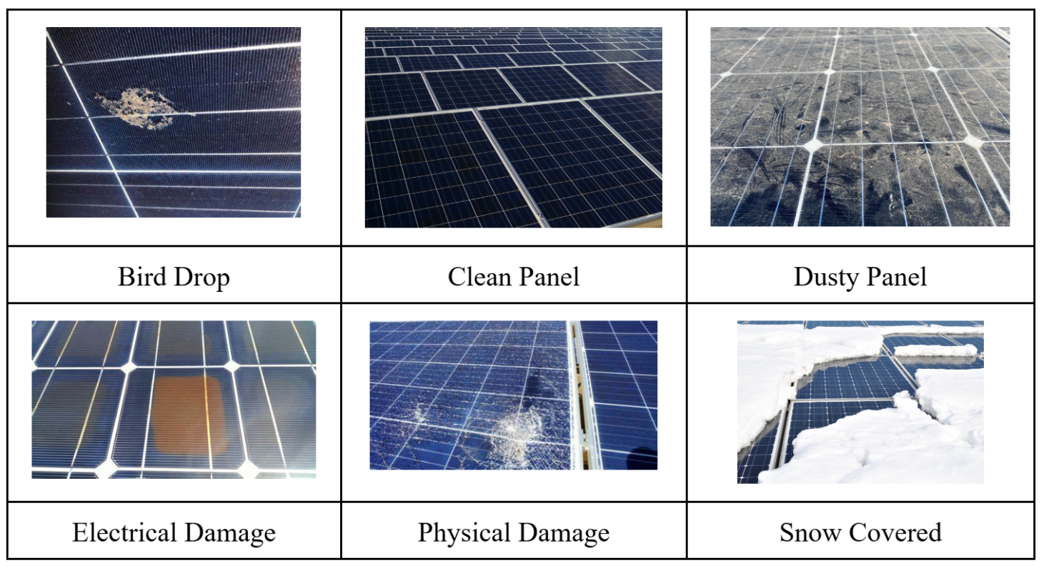
Sample data from dataset 1

Slide 12
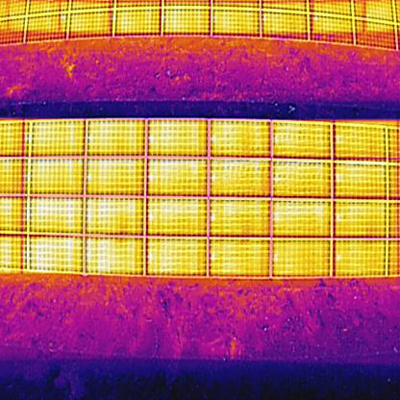
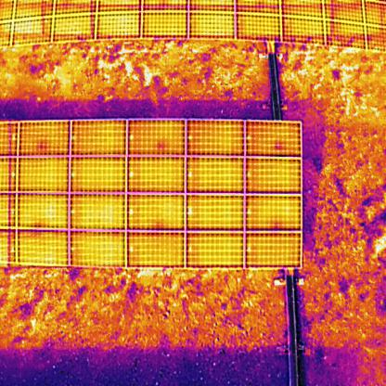
Dataset: Source 2
Dataset Source: https://universe.roboflow.com/chul-kim/pv-thermal-220413/dataset/1
Has 536 thermal images of PV cells that contains hotspots

Slide 13
Methodology and Implementation results

Slide 14
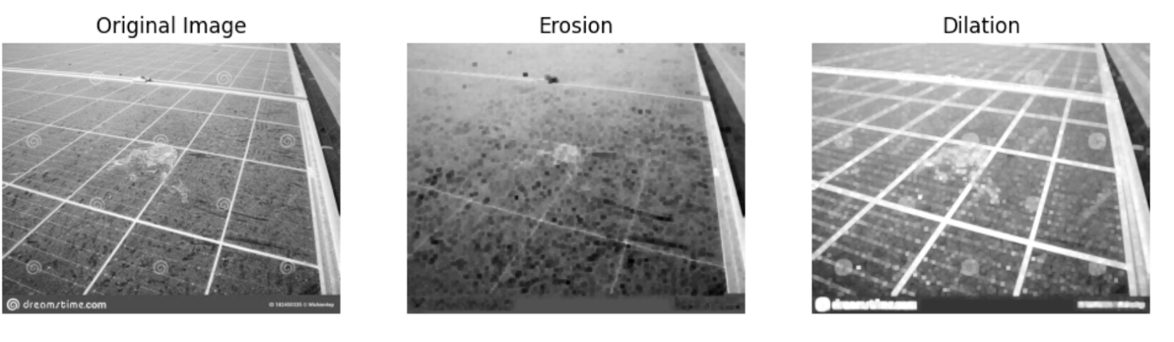
Morphological Operations
Erosion and Dilation
Erosion removes boundary pixels, shrinking the image.
Dilation adds boundary pixels, enlarging the image content.

Slide 15
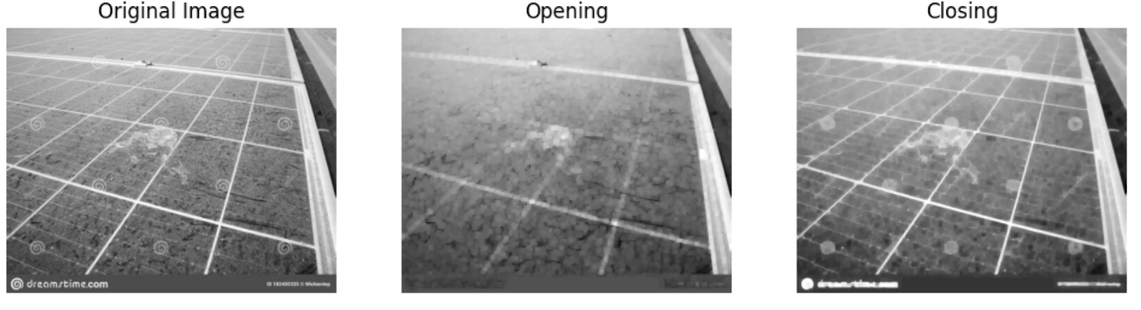
Morphological Operations
Opening and Closing
Opening involves erosion followed by dilation to remove small objects.
Closing involves dilation followed by erosion to fill narrow holes

Slide 16
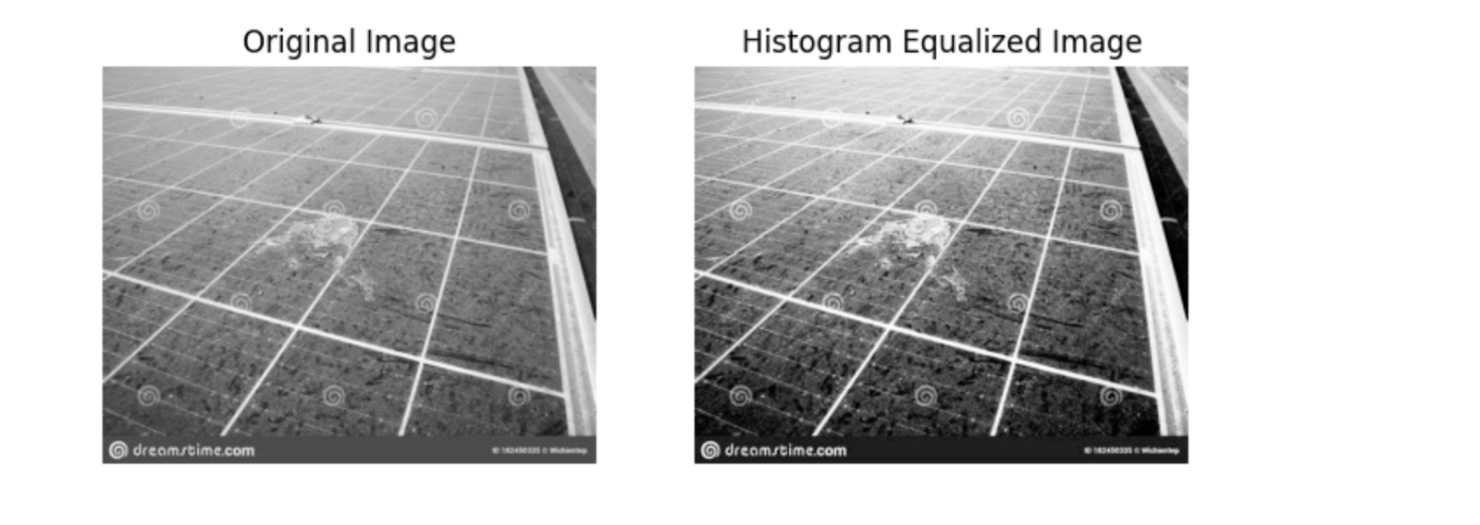
Morphological Operations
Histogram Equalization
Histogram Equalization adjusts pixel values based on their intensity histogram to enhance image contrast. This process is applied to a set of images to achieve better contrast.

Slide 17
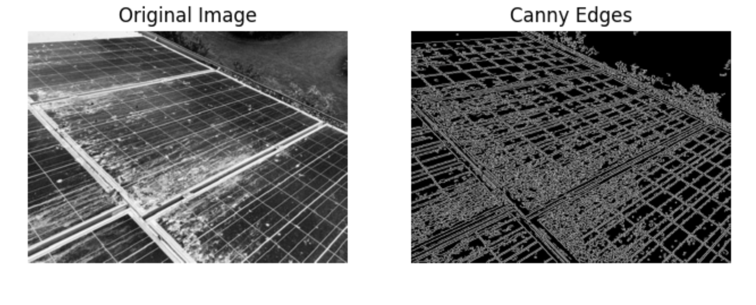
Morphological Operations
Canny Edge detection
Canny Edge Detection is a multi-step algorithm that identifies edges by reducing noise with a Gaussian filter and using threshold values to determine edge pixels. This reduces the data for processing while highlighting significant image features.

Slide 18
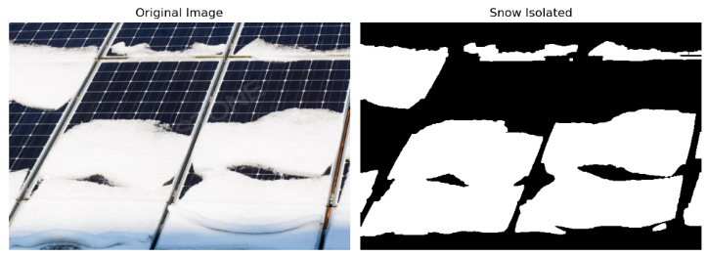
Morphological Operations
Snow patch isolation using segmentation
Snow Patch Isolation uses morphological operations for image segmentation by converting the input image to grayscale, applying a Gaussian filter for noise reduction, and using binary thresholding to identify potential snow regions. A morphological opening operation (erosion followed by dilation) refines the segmentation to isolate snow patches.

Slide 19
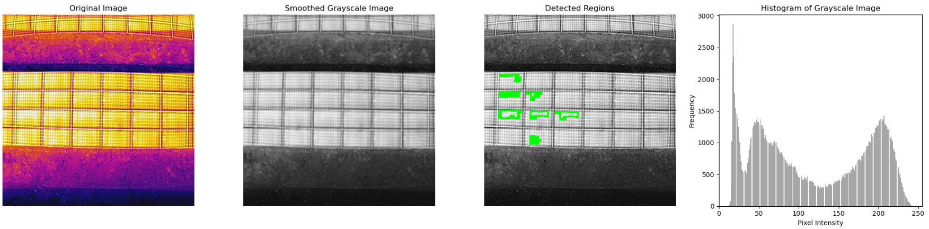
Morphological Operations
Region Detection Using Intensity Thresholding and Contour Analysis
Thermal Image Segmentation and Region Detection uses intensity thresholding and contour analysis to identify areas of interest, like hot spots, in thermal images. This involves generating a grayscale histogram, applying a Gaussian filter for noise reduction, thresholding to create a binary mask, and extracting contours of significant areas while ignoring noise.

Slide 20
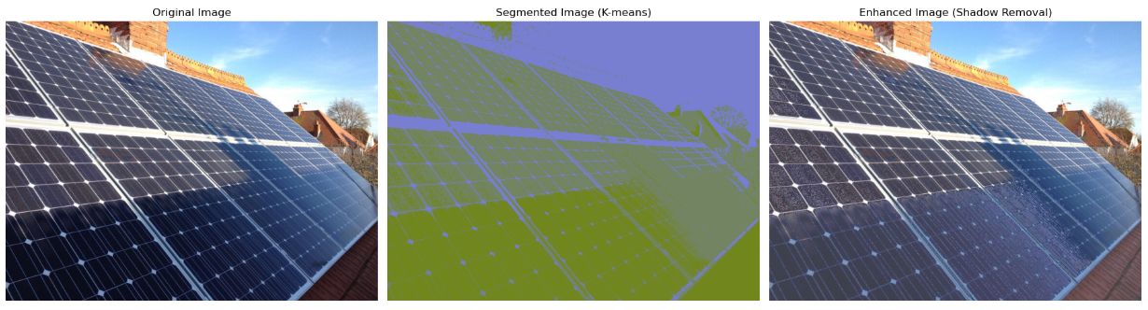
Morphological Operations - Image Pre-processing
Shadow Removal
In this project, K-means clustering was used to segment images of solar panels into three regions (background, panel, and shadows) based on color in the Lab space. The shadow region was identified and its luminance enhanced to reduce visibility. However, varying lighting conditions and similar-colored backgrounds could lead to inaccurate segmentation, causing inconsistencies in the final image enhancement.

Slide 21
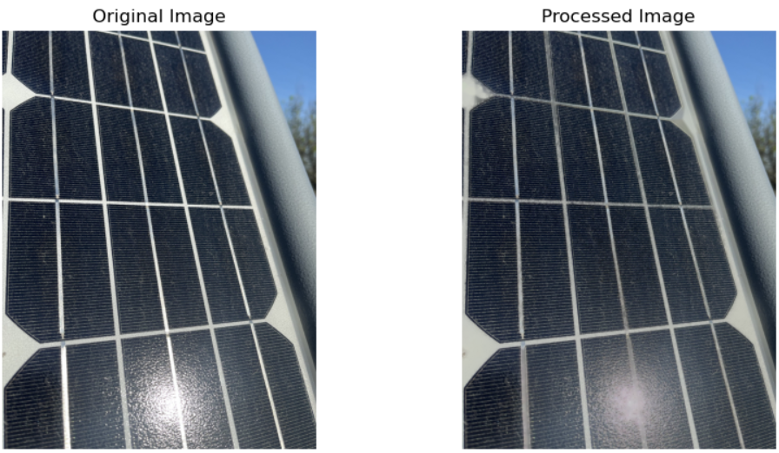
Morphological Operations - Image Pre-processing
Glare Removal
This method reduces glare in images by converting them to grayscale, applying thresholding to mark high brightness regions, and using the Telea inpainting algorithm to blend these areas with the background. However, it faces challenges with non-uniform glare, complex backgrounds, and excessive glare, which can affect its effectiveness. Despite these limitations, it provides a basic solution for glare reduction.

Slide 22
Deep Learning
Transfer learning Architectures
1. VGG16: A deep convolutional neural network with 16 layers, known for using small 3x3 filters and 2x2 max-pooling layers. It's effective for transfer learning due to its strong performance on large datasets like ImageNet.
2. MobileNetV3 Small: A lightweight, efficient neural network designed for mobile and edge devices. It uses depth-wise separable convolutions and incorporates non-linear activation functions and squeeze-and-excitation modules, making it ideal for real-time applications.
3. EfficientNetB0: A convolutional neural network that balances accuracy and computational cost using compound scaling. It features mobile inverted bottleneck convolutions and squeeze-and-excitation blocks, excelling in efficiency and performance for resource-limited devices.
4. DenseNet: A neural network architecture with densely connected layers, enhancing gradient flow, feature reuse, and efficiency. It mitigates the vanishing gradient problem and achieves high accuracy with fewer parameters, making it effective for various deep learning tasks.

Slide 23
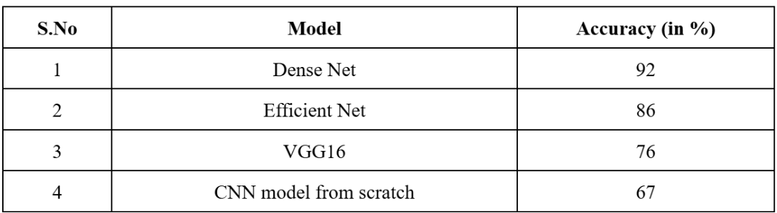
Evaluation Metrics

Slide 24
Timeline
Perform Literature survey to analyse the possible applications and research gaps in the selected field of study
Select the most appropriate and well performing model(s) and build a system utilising that
DA1
Post DA2
DA2
DA3
Select and appropriate dataset. Implement the possible methods to examine the performance of various models on the dataset
Present the proposed work in the form of a Research Paper including all the analysis and metrics

Slide 25
Conclusion
This study explores advanced image processing and deep learning for image classification and segmentation.
Morphological operations and histogram equalization improved image refinement and contrast.
Canny edge detection efficiently identified edges.
For snow patch isolation, combined techniques created binary images highlighting snow-covered areas.
In transfer learning comparisons, DenseNet excelled with a 0.92 accuracy in multi-class classification, outperforming VGG16, MobileNetV3, and EfficientNetB0.
Integrating these techniques with pre-trained CNNs provides a powerful framework for accurate and efficient image analysis, applicable in various fields.

Slide 26
References
El-Rashidy, M.A. (2022). An efficient and portable solar cell defect detection system. Neural Computing and Applications, 34, 18497–18509. https://doi.org/10.1007/s00521-022-07464-2. Published: June 18, 2022.
Di Tommaso, A., Betti, A., Fontanelli, G., & Michelozzi, B. (2022). A multi-stage model based on YOLOv3 for defect detection in PV panels based on IR and visible imaging by unmanned aerial vehicle. Renewable Energy, 193. https://doi.org/10.1016/j.renene.2022.04.046
Umar, S., Qureshi, M.S., & Nawaz, M.U. (2024). Thermal imaging and AI in solar panel defect identification. *International Journal of Advanced Engineering Technologies and Innovations*, 1(3), 73.
Wang, X., Yang, W., Qin, B., Wei, K., Ma, Y., & Zhang, D. (2022). Intelligent monitoring of photovoltaic panels based on infrared detection. Energy Reports, 8, 5005-5015. https://doi.org/10.1016/j.egyr. 2022.03.173.
Kim, S.Y., Ganesan, K., Söderman, C., et al. (2023). Spatial distribution of solar PV deployment: an application of the region-based convolutional neural network. EPJ Data Science, 12, 25. https://doi.org/10.1140/epjds/s13688-023-00399-1.
M. R. Rahman, S. Tabassum, E. Haque, M. M. Nishat, F. Faisal and E. Hossain, "CNN-based Deep Learning Approach for Micro-crack Detection of Solar Panels," 2021 3rd International Conference on Sustainable Technologies for Industry 4.0 (STI), Dhaka, Bangladesh, 2021, pp. 1-6, doi: 10.1109/STI53101.2021.9732592.
Ukiwe, E.K., Adeshina, S.A., Jacob, T. et al. Deep learning model for detection of hotspots using infrared thermographic images of electrical installations. Journal of Electrical Systems and Information Technology 11, 24 (2024). https://doi.org/10.1186/s43067-024-00148-y.
El-Shahat, D., Tolba, A., Abouhawwash, M. et al. Machine learning and deep learning models based grid search cross-validation for short-term solar irradiance forecasting. J Big Data 11, 134 (2024). https://doi.org/10.1186/s40537-024-00991-w.
Kirubakaran, V., Preethi, D. M. D., Arunachalam, U., Rao, Y. K. S. S., Gatasheh, M. K., Hoda, N., & Anbese, E. M. (2022). Infrared thermal images of solar PV panels for fault identification using image processing technique. The Scientific World Journal, 2022, Article ID 6427076. https://doi.org/10.1155/2022/6427076
Liao, K. C. and Lu, J. H. (2020). Using Matlab real-time image analysis for solar panel fault detection with UAV. Journal of Physics: Conference Series, 1509, 012010. The 10th Asian-Pacific Conference on Aerospace Technology and Science & The 4th Asian Joint Symposium on Aerospace Engineering (APCATS'2019 / AJSAE'2019), 28-31 August 2019, National Chiao Tung University, Hsin Chu, Taiwan. https://doi.org/10.1088/1742-6596/1509/1/012010
AlMarzooqi, H. (2023). Defect Detection of Photovoltaic Panels by Image Processing. Rochester Institute of Technology.
​​Zhang, X., & Araji, M. T. (2023). Snow loss modeling for solar modules using image processing and deep learning. Sustainable Energy, Grids and Networks, 34, 101036. https://doi.org/10.1016/j.segan.2023.101036.
Patel, A.V., McLauchlan, L., & Mehrubeoglu, M. (2024). Defect Detection in PV Arrays Using Image Processing. Department of Electrical Engineering and Computer Science, Texas A&M University-Kingsville, Kingsville, Texas, USA
Hu, X., Du, Z. & Wang, F. Research on detection method of photovoltaic cell surface dirt based on image processing technology. Sci Rep 14, 16842 (2024). https://doi.org/10.1038/s41598-024-68052-z
Vlaminck, M., Heidbuchel, R., Philips, W., & Luong, H. (2022). Region-Based CNN for Anomaly Detection in PV Power Plants Using Aerial Imagery. Sensors, 22(3), 1244. https://doi.org/10.3390/s22031244.
M. Zhang and L. Yin, "Solar Cell Surface Defect Detection Based on Improved YOLO v5," in IEEE Access, vol. 10, pp. 80804-80815, 2022, doi: 10.1109/ACCESS.2022.3195901.
Prabhakaran, S., Uthra, R. A., & Preetharoselyn, J. (2023). Deep learning-based model for defect detection and localization on photovoltaic panels. Computer Systems Science & Engineering, https://doi.org/10.32604/csse.2023.028898.
S. Salamanca, P. Merchán and I. García, "On the detection of solar panels by image processing techniques," 2017 25th Mediterranean Conference on Control and Automation (MED), Valletta, Malta, 2017, pp. 478-483, doi: 10.1109/MED.2017.7984163.
Natarajan, K., Bala, P.K., & Sampath, V. (2020). Fault Detection of Solar PV System Using SVM and Thermal Image Processing. International Journal of Renewable Energy Research (IJRER), 10(2).
Anwar, S.A., Abdullah, M.Z. Micro-crack detection of multicrystalline solar cells featuring an improved anisotropic diffusion filter and image segmentation technique. J Image Video Proc 15, (2014). https://doi.org/10.1186/1687-5281-2014-15

Slide 27
Thank You

